Slide 1
Recommender Systems
Claudio Lucchese claudio.lucchese@unive.it

Slide 2


Goal
To recommend interesting stuff:
Songs, movies, web-pages, (queries…), …
Popular items vs. the Long Tail
There is a lot of money in the tail
Recommending popular stuff may not be sufficient
Really understand what a user is looking for
Several different approaches:

Slide 3
Quality Measures
Efficiency in building the model
How expensive is to process our data and build the recommender system?
Efficiency in generating suggestions
How expensive is to produce recommendations at run-time
Serendipity of recommendations
Are recommendations novel and interesting?
Cold-start problem
What when we know little about users?

Slide 4
Any Idea ?
What about a song recommender system?

Slide 5
Content-based Recommender systems
A user is the set of songs she listened
Define the song representation
E.g., on the basis of the song lyrics
Define the user profile
E.g., aggregate (Sum/Avg) descriptions of listened songs
Similarity-based Recommendation
Recommend the songs most similar to the user profile
This can be generalized to:
Movies, e-commerce, Web pages, etc. etc.

Slide 6
A bit of terminology
Users:
"You and me”
denoted as the set U
Items:
The objects being recommended
denoted as the set I

Slide 7
Content-based Recommender systems
We model text by using the vector space model:
Each item x∊ I is a vector of size N
where N is the number of words in the lexicon
Stemming, lemmatization, stop-word removal applies here
x[t] = tf(t,x) idf(t)
tf(t,x) is the frequency of term t in item x
idf(t) is the inverse document frequency of t in I
The profile of a user u is the average of the items I_{u} he interacted with:
Notes:
u = \frac{1}{|I_u|}\sum_{x \in I_u} x
\cos(x,y)= \frac{x \cdot y}{\|x\| \|y\|} = \frac{\sum_t x[t]\cdot y[t]}{\sqrt{\sum_t x[t]^2}\sqrt{\sum_t y[t]^2}}

Slide 8
Content-based Recommender systems
We model text by using the vector space model:
Given a user u and an item x, their similarity is as the cosine of the two vectors:
The recommender system returns the top-k most similar items to the user profile
Notes:
\cos(u,x)= \frac{u \cdot x}{\|u\| \|x\|} = \frac{\sum_t u[t]\cdot x[t]}{\sqrt{\sum_t u[t]^2}\sqrt{\sum_t x[t]^2}}

Slide 9
Content-based – Wrap up
Efficiency in building the model
Easy processing for the corpus
Cheap model for the user
Efficiency in generating suggestions
Not cheap Nearest neighbor search among the collection of documents
Serendipity of recommendations
Small, tied to text similarity
Cold-start problem
Partial, user should “touch” at list one item first
Other:
Text representation has some non trivial issues: synonymy, polysemy, ….

Slide 10
Any idea?
What information we are not using ?

Slide 11
A bit of terminology
Users:
"You and me”
denoted as the set U
Items:
The objects being recommended
denoted as the set I
Rating:
The feedback provided by the user
Rating Matrix:
A matrix |U|x|I| where each entry stores the user feedback
Denoted as R[u,i]

Slide 12
User-based Collaborative Filtering
Rather then finding similar items, find similar users!
Greater serendipity !
In many cases, users rate items
Explicit: stars
Implicit: time on a web page, clicks on a result page
The algorithm:
Find a set neighbors N(u) of users similar to u
Exploit the rating of users N(u) to build recommendations for u

Slide 13
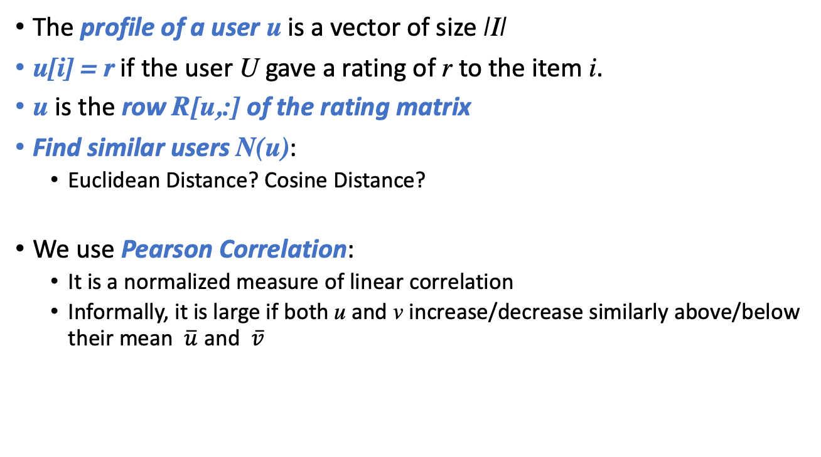
User-based Collaborative Filtering
The profile of a user u is a vector of size |I|
u[i] = r if the user U gave a rating of r to the item i.
u is the row R[u,:] of the rating matrix
Find similar users N(u):
Euclidean Distance? Cosine Distance?
We use Pearson Correlation:
It is a normalized measure of linear correlation
Informally, it is large if both u and v increase/decrease similarly above/below their mean $\overline{u}$ and $\overline{v}$
Notes:
\rho(u,v) = \frac{{\sf cov} (u,v)}{\sigma_u \sigma_v} = \frac{\sum_i(u[i]-\bar{u})(v[i]-\bar{v}) }{\sqrt{\sum_i(u[i]-\bar{u})^2} \sqrt{\sum_i(v[i]-\bar{v})^2}}
Cosine does not really work for u1=[1,2] u2=[3,6]
Still they are the same if normalized around the mean

Slide 14
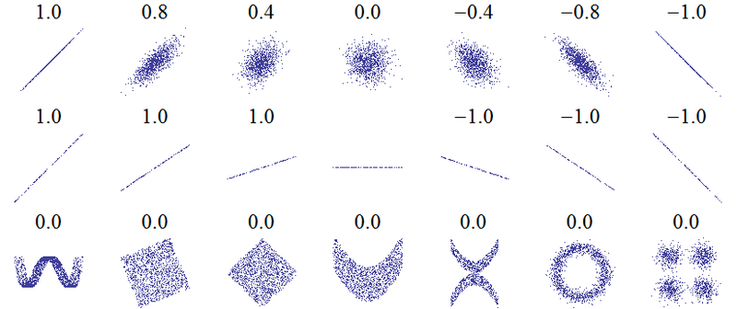
Pearson Correlation

Slide 15
User-based Collaborative Filtering
Build recommendations by ranking:
For each item i∊ I compute a ranking score s_{ui}:
By considering rating of users in N(u)
By weighting those rating by the users’ similarity with u
Eventually, s_{ui} is used to rank every item in I
We upgrade the formula to predict the rating by u
Notes:
s_{ui} = \frac{\sum_{v \in N(u)} (v[i] - \bar{v}) \cdot \rho(u,v)}{\sum_{v \in N(u)} |\rho(u,v)|}
r_{ui}= \bar{u} + s_{ui}= \bar{u} + \frac{\sum_{v \in N(u)} (v[i] - \bar{v}) \cdot \rho(u,v)}{\sum_{v \in N(u)} |\rho(u,v)|}

Slide 16
User-based Collaborative Filtering – Wrap up
Efficiency in building the model
User similarity is expensive - O(|U|²)
Very expensive even if done off-line
For every new rating by a user, similarities should be recomputed
Efficiency in generating suggestions
Nearest neighbor search is not needed if pre-computed off-line
Serendipity of recommendations
Great !
Cold-start problem
We need a sufficiently large set of ratings for a new user/item
Sparsity:
Few ratings and few shared ratings

Slide 17
Any idea?
How to reduce the cost of user-based similarities?
Do we have a different «point of view» ?

Slide 18
Item-based Collaborative Filtering
Symmetric approach based on item similarity!
An item i is represented by a vector of size |U|
i[u] = r if the user U gave a rating of r to the item i.
i is the column R[:,i] of the rating matrix
Rationale:
What is the score that user u gave to items similar to i ?
The algorithm:
To estimate the score for an item i
Find a set N(i) of other items rated by u and similar to i
Exploit the ratings of user u for items in N(i) to compute a score for i

Slide 19
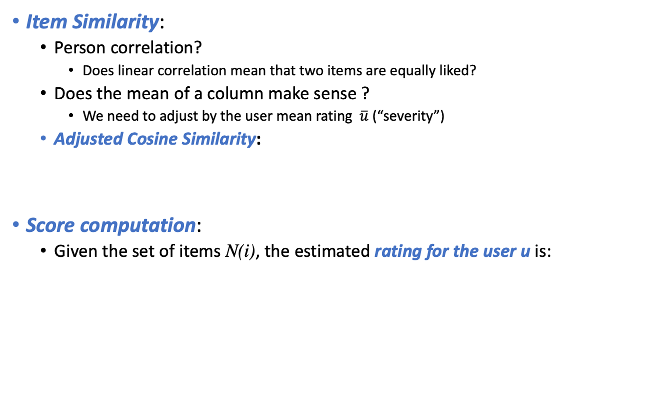
Item-based Collaborative Filtering
Item Similarity:
Person correlation?
Does linear correlation mean that two items are equally liked?
Does the mean of a column make sense ?
We need to adjust by the user mean rating $\overline{u}$ (“severity”)
Adjusted Cosine Similarity:
Score computation:
Given the set of items N(i), the estimated rating for the user u is:
Notes:
{\sf a-}\!\cos(i,j)= \frac{\sum_u (i[u]-\bar{u}) (j[u]-\bar{u})}{\sqrt{\sum_u (i[u]-\bar{u})^2}\sqrt{\sum_u (j[u]-\bar{u})^2}}
r_{ui} = \frac{\sum_{j\in N(i)}R[j,u]\cdot {\sf a-}\!\cos(i,j)}{\sum_{j\in N(i)} |{\sf a-}\!\cos(i,j)|}

Slide 20
Experiments on
Movie lens dataset:
3500 movies
43000 users
Quality Measure:
On a subset of N ratings
Mean Absolute Error:
Notes:
{\sf MAE} = \frac{\sum_{i=1}^N |R[u,i] - s[i]|}{N}

Slide 21
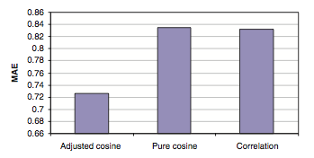
Does it make any difference ?
Lower is better

Slide 22
Item-based Collaborative Filtering – Wrap up
Efficiency in building the model
|I| is usually smaller than |U|, this makes the computation cheaper than user-based
Computation is offline
Efficiency in generating suggestions
Nearest neighbor search is not needed if pre-computed off-line
Serendipity of recommendations
Less than user-based, as final ranking depends on ratings by the current user
Cold-start problem
We need a sufficiently large set of ratings for a new user/item
Sparsity:
Items have larger probability of sharing ratings
Used by Amazon !

Slide 23
Some examples
Try implementing it yourself
https://grouplens.org/datasets/movielens/
Better taking a large dataset
Star Trek: The Motion Picture (1979)
The most similar movies are:
Star Trek III: The Search for Spock (1984)
Star Trek IV: The Voyage Home (1986)
Star Trek II: The Wrath of Khan (1982)
Star Trek V: The Final Frontier (1989)
Fantasia (1940)
The most similar movies are:
Wizard of Oz, The (1939)
Pinocchio (1940)
Alice in Wonderland (1951)
Cinderella (1950)
Fight Club (1999)
The most similar movies are:
Matrix, The (1999)
Memento (2000)
Lord of the Rings:
The Fellowship of the Ring, The (2001)

Slide 24
Is this enough to win the netflix prize?

Slide 25
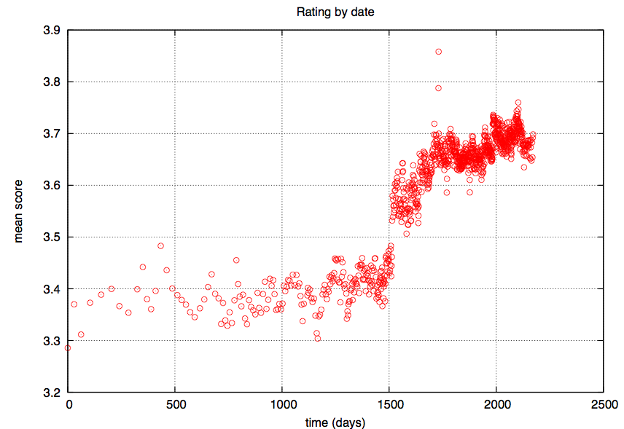
Effects of time
Notes:
Cinematch improvement
l change of the labels associated with the star scores. While at the present, stars reflect subjective feelings on the movies (e.g., 5 stars=“loved it”, 4 stars=“really liked it”), in the past they might have used to denote a more objective quality (e.g., 5 stars=“superb movie”), setting a higher bar for a 5 star rating
Cine- match suggestions drive 60% of Netflix’s rentals

Slide 26
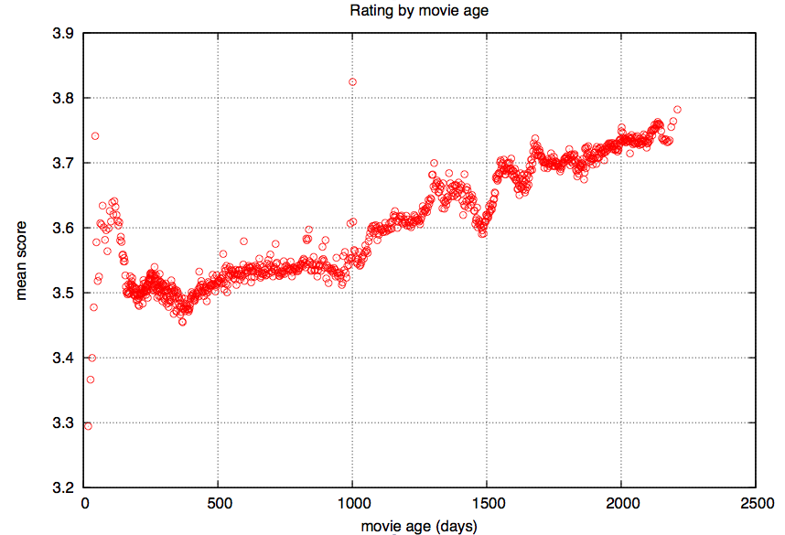
Effects of Time
Notes:
Older movies are getting rated by users better matching them. This might indicate that people watch (and then rate) a new
movie even if it is less appropriate for them, but will watch an older movie only after a more careful selection process. Such an improved match between users and movies can be captured by the fact that the interaction part of the model is rising with movies’ age

Slide 27
So What ??
Was it worthwhile ??
Yes!
Anything else?
Yes: Factor analysis, Singular Value Decomposition, …
Yehuda Koren. Collaborative Filtering with Temporal Dynamics. KDD 2009

Slide 28
References
Recommender Systems Handbook. Francesco Ricci, Lior Rokach, Bracha Shapira, Paul B. Kantor, Springer.
http://www.cs.ubbcluj.ro/~gabis/DocDiplome/SistemeDeRecomandare/Recommender_systems_handbook.pdf
Chapter 1: Introduction
Chapter 4: A Comprehensive Survey of Neighborhood-based Recommendation Methods
Excluding Sections 4.2.2 e 4.2.3
Until Section 4.3.2.1 (included)
Notes:
Linden, G.; Smith, B.; York, J. . Amazon.com recommendations: item-to-item collaborative filtering. IEEE Internet Computing 2001.
Badrul Sarwar, George Karypis, Joseph Konstan, and John Riedl. Item-Based Collaborative Filtering Recommendation Algorithms. WWW 2001.

Slide 29
Extra

Slide 30

Baseline Predictors
μ is the average rating over every item and every user
b_{u} models how much the user u is different from the average
b_{i} models how much item i is different from the average
All of the above can be computed by “mining” the available movie ratings
It is a minimization problem, where the error of the prediction is minimized
Gradient descent is one was to find the minimum of a function

Slide 31

Incorporating Time in Item predictors
b_{u} and b_{i} are a function of time
Discretize time into bins
E.g. each bin corresponds to 10 weeks

Slide 32

Incorporating Time in Users predictors
Modeling of user drift in time
t_{u} is the mean day of rating
β controls the “speed” of the linear drift
α_{u} is a per user weight of the time drift impact
Finally, to model single day effects b_{u,t} is added:
Notes:
Users give same rating son the same day

Slide 33
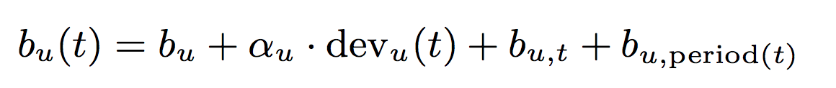
Not yet there… Periodicity
Items may be more appealing in different times:
E.g., {Spring, Summer, Fall, Winter}
User may change behavior over time:
(e.g. Monday, Tuesday, …, Sunday)

Slide 34
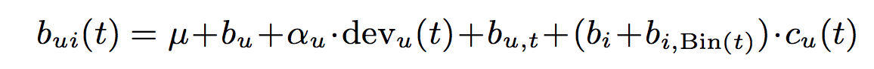
Baseline item predictor is not completely user independent
Users have different rating scales over time:

Slide 35
Putting it all together
We predict the score for an item by merging the baseline predictors with the item-based CF
Additionally, temporal dynamics are added to CF
contribution of item j is discounted “exponentially” by the following factor:
Notes:
s_{ui}(t) = \frac{\sum_{j\in N(i)}R[i,u]\cdot {\sf a-}\!\cos(i,j)}{\sum_{j\in N(i)}{\sf a-}\!\cos(i,j)} + b_{ui}(t)

